Slide 1
Watch Tutorials On My YouTube Channel
👇
https://www.youtube.com/channel/UCyznftKKSTDfJdH97pphHCg/
Learn How To Design Overlapped Text Effect
👇
https://www.youtube.com/watch?v=-hmbycbiVNc

Slide 2
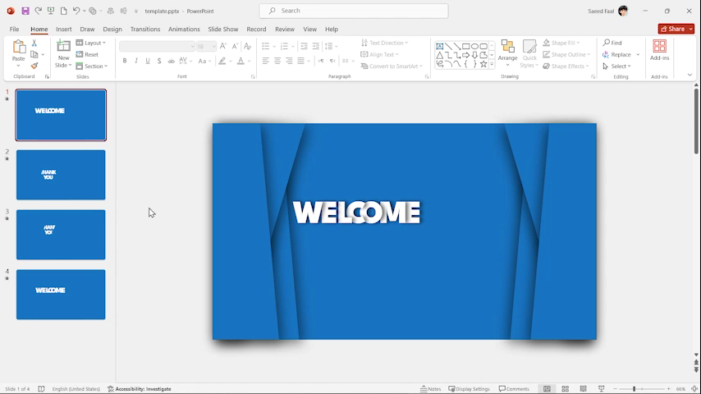
Tutorial

Slide 3
IMPORTANT
If you don’t install the fonts, you won’t see the slides like the original one
Font:
https://fonts.google.com/specimen/League+Spartan

Slide 4
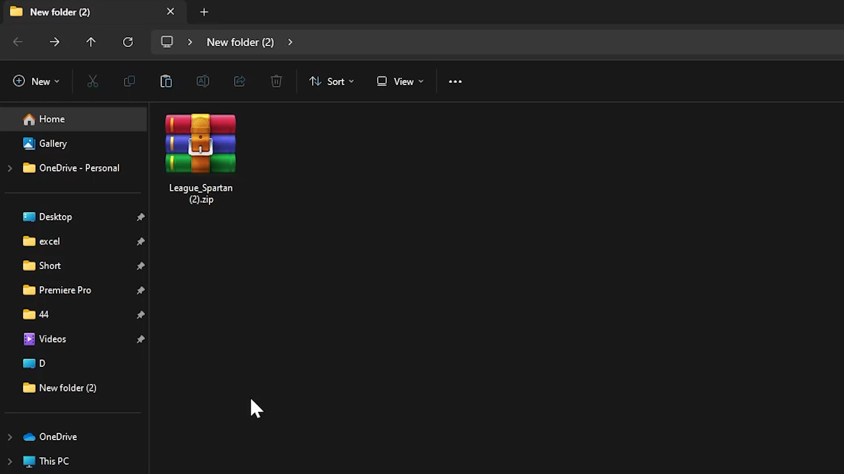
HOW TO INSTALL A FONT

Slide 5


Slide 6

By Saeed Faal

Slide 7
By Saeed Faal

Slide 8
By Saeed Faal

